Slide 1
Introduction to Deep Learning

Slide 2
Outline
Machine Learning basics
Introduction to Deep Learning
what is Deep Learning
why is it useful
Main components/hyper-parameters:
activation functions
optimizers, cost functions and training
regularization methods
tuning
classification vs. regression tasks
DNN basic architectures:
convolutional
recurrent
attention mechanism
Application example: Relation Extraction
x
Backpropagation
GANs & Adversarial training
Bayesian Deep Learning
Generative models
Unsupervised / Pretraining
Most material from CS224 NLP with DL course at Stanford

Slide 3
Machine Learning Basics
Machine learning is a field of computer science that gives computers the ability to learn without being explicitly programmed
Labeled Data
Machine Learning algorithm
Training
Prediction
Labeled Data
Learned model
Prediction
Methods that can learn from and make predictions on data

Slide 4
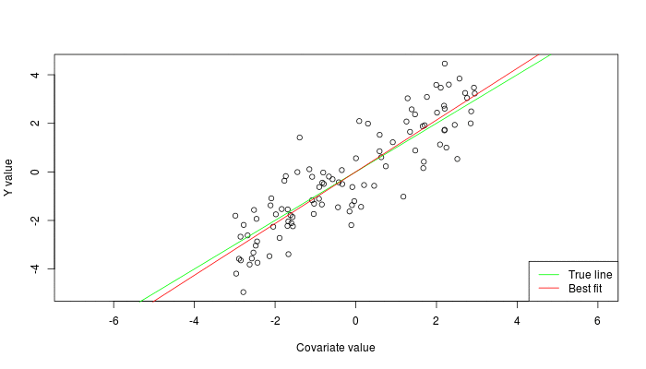


Types of Learning
Supervised: Learning with a labeled training set
Example: email classification with already labeled emails
Unsupervised: Discover patterns in unlabeled data
Example: cluster similar documents based on text
Reinforcement learning: learn to act based on feedback/reward
Example: learn to play Go, reward: win or lose
class A
class A
Classification
Regression
Clustering
Anomaly Detection
Sequence labeling
…
http://mbjoseph.github.io/2013/11/27/measure.html

Slide 5
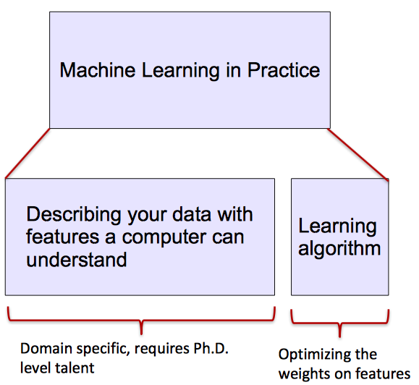
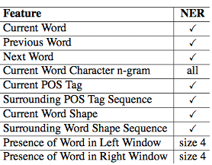
ML vs. Deep Learning
Most machine learning methods work well because of human-designed representations and input features
ML becomes just optimizing weights to best make a final prediction

Slide 6
Today’s Topics
Neural Networks for Spatial Data
History of Convolutional Neural Networks (CNNs)
CNNs – Convolutional Layers
CNNs – Pooling Layers
Programming tutorial

Slide 7






Historical Context: Inspiration
Nobel Prize in Physiology and Medicine to Hubel and Weisel
1847 1945 1950 1980 1986 1989
1957
1956
1959
2012
Gradient descent
First programmable machine
Turing test
AI
Perceptron
Machine learning
Neuroscientific experiments by Hubel & Weisel to understand how mammalian vision system works
Neural networks with effective learning strategy
Universal approximation paper
Wave 3: rise of “deep learning”

Slide 8
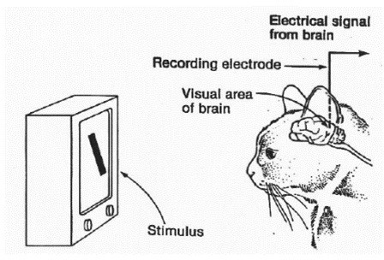
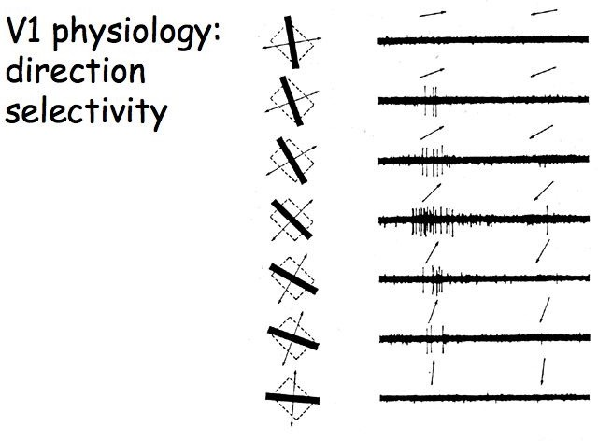
Motivation: How Vision System Works
Key Finding: initial neurons responded strongly
Experiment Set-up:
only when light was shown in certain orientations
https://www.esantus.com/blog/2019/1/31/convolu tional-neural-networks-a-quick-guide-for-newbies
https://www.cns.nyu.edu/~david/courses
/perception/lecturenotes/V1/lgn-V1.html

Slide 9
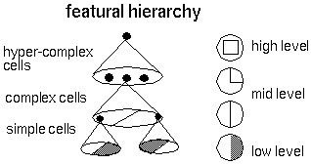
Motivation: How Vision System Works
Key Idea: cells are organized as a hierarchy of feature detectors, with higher level features responding to patterns of activation in lower level cells
Source: https://bruceoutdoors.files.wordpress.com/2017/08/hubel.jpg

Slide 10
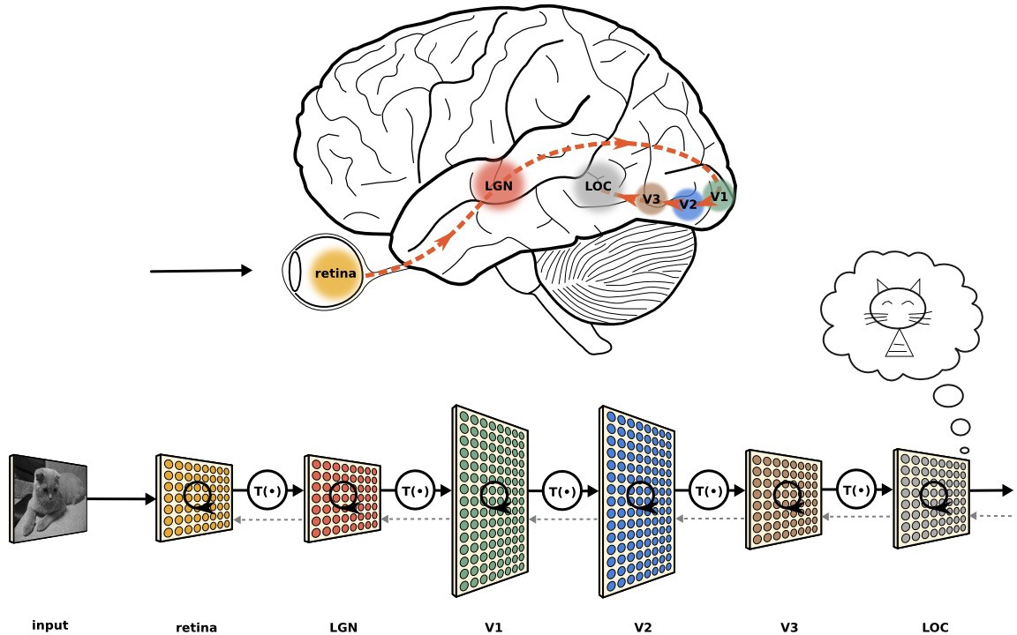
Motivation: How Vision System Works
https://neuwritesd.files.wordpress.com/2015/10/visual_stream_small.png

Slide 11
Historical Context: Key Ingredients
Nobel Prize in Physiology and Medicine to Hubel and Weisel
1847 1945 1950 1980 1986 1989
1957
1956
1959
2012
Gradient descent
First programmable machine
Turing test
AI
Perceptron
Machine learning
Neuroscientific experiments to understand how mammalian vision system works
Neocognitron: convolutional layers and downsampling layers
Neural networks with effective learning strategy
Universal approximation paper
Wave 3: rise of “deep learning”

Slide 12
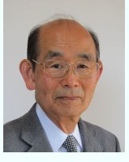
Neocognitron: Key Ingredients
“In this paper, we discuss how to synthesize a neural network model in order to endow it an ability of pattern recognition like a human being… the network acquires a similar structure to the hierarchy model of the visual nervous system proposed by Hubel and Wiesel.”
- Fukushima, Neocognitron: A Self-organizing Neural Network Model for a Mechanism of Pattern Recognition Unaffected by Shift in Position. Biological Cybernetics, 1980.
http://personalpage.flsi.or.j p/fukushima/index-e.html

Slide 13
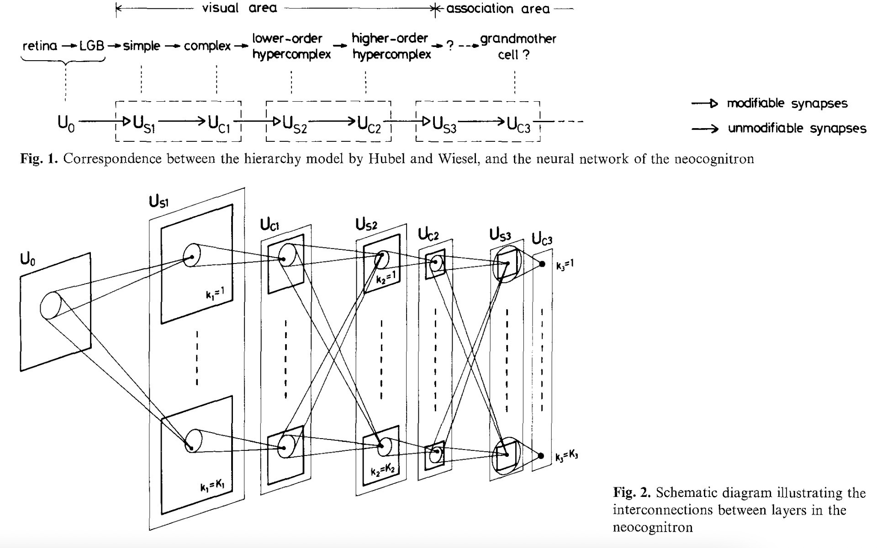
Neocognitron: Key Ingredients
Cascade of simple and complex cells:
Fukushima, 1980.

Slide 14
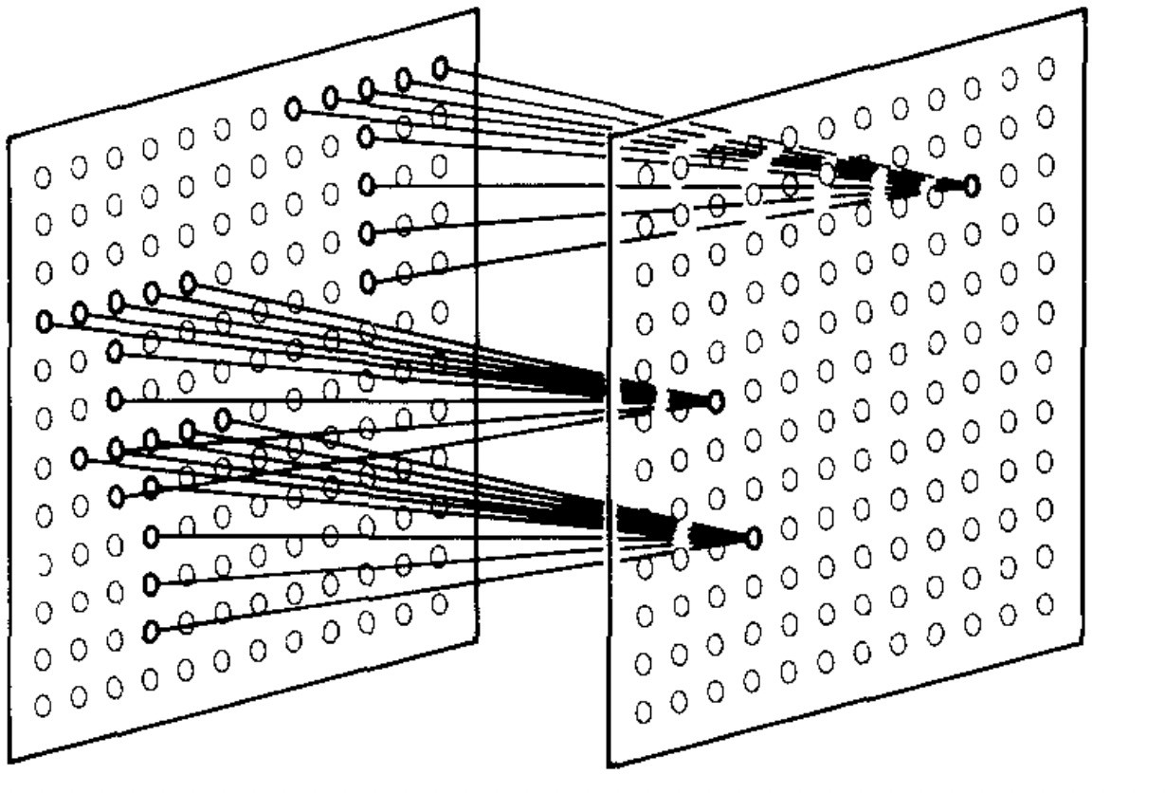
Neocognitron: Key Ingredients
Simple cells extract local features using a sliding filter:
Fukushima, 1980.

Slide 15
Neocognitron: Key Ingredients
Complex cells fire when any part of the local region is the desired pattern
Fukushima, 1980.

Slide 16
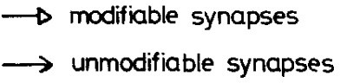
Neocognitron: Key Ingredients
1. Convolutional layers
2. Pooling Layers
Note: modern networks similarly alternate between these two types of layers!
Fukushima, 1980.

Slide 17

What is Deep Learning (DL) ?
A machine learning subfield of learning representations of data. Exceptional effective at learning patterns.
Deep learning algorithms attempt to learn (multiple levels of) representation by using a hierarchy of multiple layers
If you provide the system tons of information, it begins to understand it and respond in useful ways.
https://www.xenonstack.com/blog/static/public/uploads/media/machine-learning-vs-deep-learning.png

Slide 18
So, 1. what exactly is deep learning ?
And, 2. why is it generally better than other methods on image, speech and certain other types of data?

Slide 19
So, 1. what exactly is deep learning ?
And, 2. why is it generally better than other methods on image, speech and certain other types of data?
The short answers
1. ‘Deep Learning’ means using a neural network
with several layers of nodes between input and output
2. the series of layers between input & output do
feature identification and processing in a series of stages,
just as our brains seem to.

Slide 20
hmmm… OK, but:
3. multilayer neural networks have been around for 25 years. What’s actually new?

Slide 21
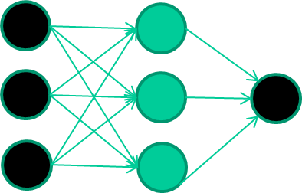
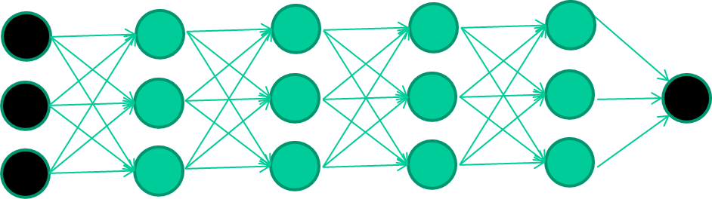
hmmm… OK, but:
3. multilayer neural networks have been around for
25 years. What’s actually new?
we have always had good algorithms for learning the
weights in networks with 1 hidden layer
but these algorithms are not good at learning the weights for
networks with more hidden layers
what’s new is: algorithms for training many-later networks

Slide 22
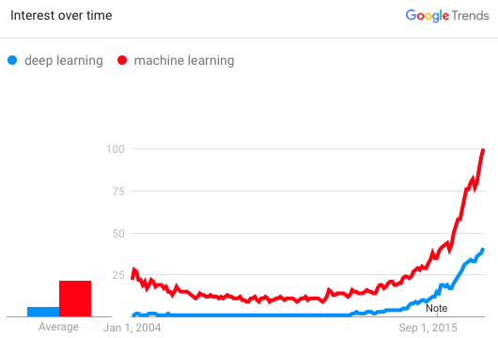
Why is DL useful?
Manually designed features are often over-specified, incomplete and take a long time to design and validate
Learned Features are easy to adapt, fast to learn
Deep learning provides a very flexible, (almost?) universal, learnable framework for representing world, visual and linguistic information.
Can learn both unsupervised and supervised
Effective end-to-end joint system learning
Utilize large amounts of training data
In ~2010 DL started outperforming other ML techniques
first in speech and vision, then NLP

Slide 23
Key components of DL
Neural Networks,
Layers,
Activation Functions,
Loss Functions,
Optimizers

Slide 24
Key components of CNNs
Convolutional Layers (Filters, Strides, Padding)
Pooling Layers (Max Pooling, Average Pooling)
Fully Connected Layers

Slide 25
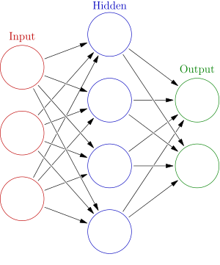


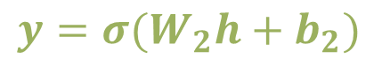
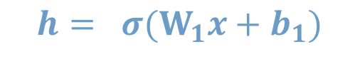
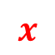
Neural Network Intro
Weights
$$h= σ(W_{1}x+b_{1})$$
$$y=σ(W_{2}h+b_{2})$$
Activation functions
How do we train?
$$y$$
$$x$$
4 + 2 = 6 neurons (not counting inputs)
[3 x 4] + [4 x 2] = 20 weights
4 + 2 = 6 biases
26 learnable parameters
$$h$$
Demo
Notes:
Hyper-parameters

Slide 26

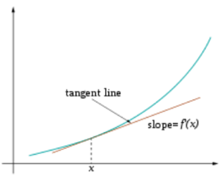
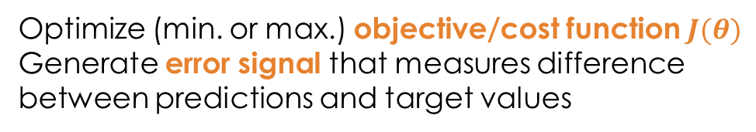
Training
Sample labeled data
(batch)
Forward it through the network, get predictions
Back-propagate the errors
Update the network weights
Optimize (min. or max.) objective/cost function $J(θ)$
Generate error signal that measures difference between predictions and target values
Use error signal to change the weights and get more accurate predictions
Subtracting a fraction of the gradient moves you towards the (local) minimum of the cost function
https://medium.com/@ramrajchandradevan/the-evolution-of-gradient-descend-optimization-algorithm-4106a6702d39

Slide 27
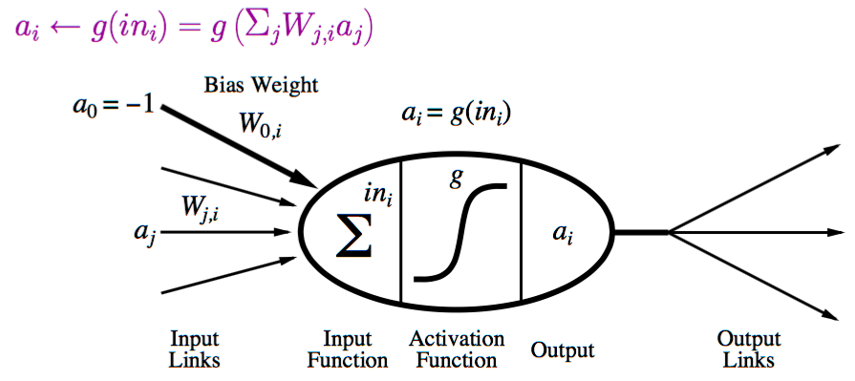
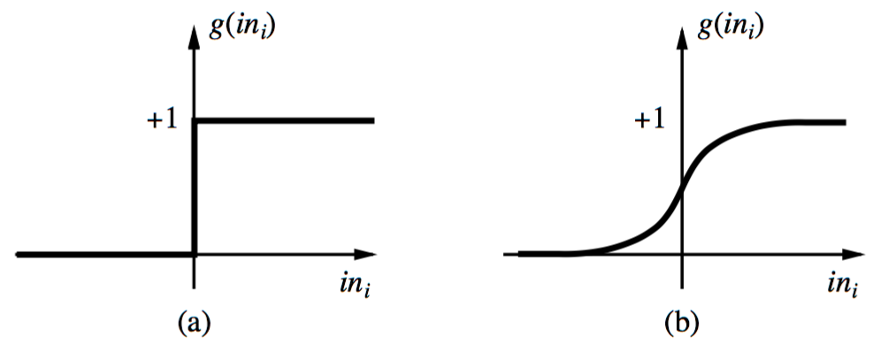
Neural Network: A Neuron
A neuron is a computational unit in the neural network that exchanges messages with each other.
Possible activation functions:
Step function/threshold function
Sigmoid function (a.k.a, logistic function)

Slide 28
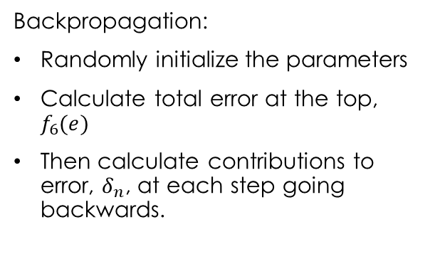
Feed forward/Backpropagation Neural Network
Feed forward algorithm:
Activate the neurons from the bottom to the top.
Backpropagation:
Randomly initialize the parameters
Calculate total error at the top, $f_{6}(e)$
Then calculate contributions to error, $δ_{n}$, at each step going backwards.

Slide 29
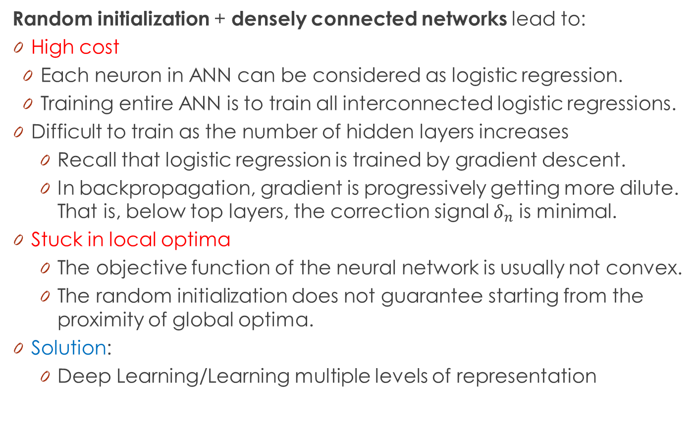
Limitations of Neural Networks
Random initialization + densely connected networks lead to:
High cost
Each neuron in ANN can be considered as logistic regression.
Training entire ANN is to train all interconnected logistic regressions.
Difficult to train as the number of hidden layers increases
Recall that logistic regression is trained by gradient descent.
In backpropagation, gradient is progressively getting more dilute. That is, below top layers, the correction signal $δ_{n}$ is minimal.
Stuck in local optima
The objective function of the neural network is usually not convex.
The random initialization does not guarantee starting from the proximity of global optima.
Solution:
Deep Learning/Learning multiple levels of representation

Slide 30

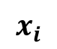
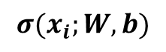
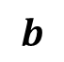
One forward pass
Text (input) representation
TFIDF
Word embeddings
….
0.2 | -0.5 | 0.1
2.0 | 1.5 | 1.3
0.5 | 0.0 | 0.25
-0.3 | 2.0 | 0.0
0.1
0.2
0.3
1.0
3.0
0.025
0.0
0.95
3.89
0.15
0.37
very positive
positive
negative
very negative
$$W$$
$$x_{i}$$
$$b$$
$$σ(x_{i};W, b)$$

Slide 31
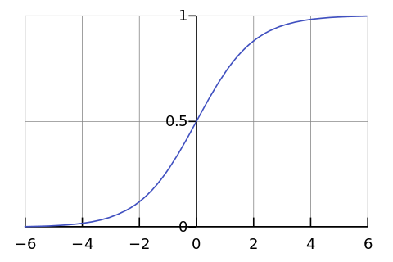
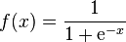
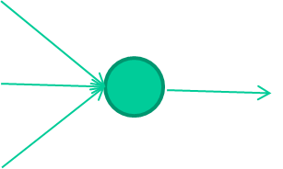
-0.06
W1
W2
f(x)
-2.5
W3
1.4

Slide 32
-0.06
2.7
-8.6
f(x)
-2.5
0.002
x = -0.06×2.7 + 2.5×8.6 + 1.4×0.002 = 21.34
1.4

Slide 33
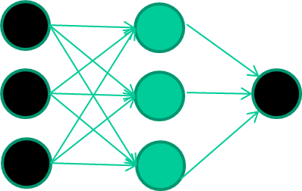
A dataset
Fields class
1.4 2.7 1.9 0
3.8 3.4 3.2 0
6.4 2.8 1.7 1
4.1 0.1 0.2 0
etc …

Slide 34
Training the neural network
Fields class
1.4 2.7 1.9 0
3.8 3.4 3.2 0
6.4 2.8 1.7 1
4.1 0.1 0.2 0
etc …

Slide 35
Training data
Fields class
1.4 2.7 1.9 0
3.8 3.4 3.2 0
6.4 2.8 1.7 1
4.1 0.1 0.2 0
etc …
Initialise with random weights

Slide 36
Training data
Fields class
1.4 2.7 1.9 0
3.8 3.4 3.2 0
6.4 2.8 1.7 1
4.1 0.1 0.2 0
etc …
Present a training pattern
1.4
2.7
1.9

Slide 37
Training data
Fields class
1.4 2.7 1.9 0
3.8 3.4 3.2 0
6.4 2.8 1.7 1
4.1 0.1 0.2 0
etc …
Feed it through to get output
1.4
2.7 0.8
1.9

Slide 38
Training data
Fields class
1.4 2.7 1.9 0
3.8 3.4 3.2 0
6.4 2.8 1.7 1
4.1 0.1 0.2 0
etc …
Compare with target output
1.4
2.7 0.8
0
1.9 error 0.8

Slide 39


Training data
Fields class
1.4 2.7 1.9 0
3.8 3.4 3.2 0
6.4 2.8 1.7 1
4.1 0.1 0.2 0
etc …
Adjust weights based on error
1.4
2.7 0.8
0
1.9 error 0.8

Slide 40
Training data
Fields class
1.4 2.7 1.9 0
3.8 3.4 3.2 0
6.4 2.8 1.7 1
4.1 0.1 0.2 0
etc …
Present a training pattern
6.4
2.8
1.7

Slide 41
Training data
Fields class
1.4 2.7 1.9 0
3.8 3.4 3.2 0
6.4 2.8 1.7 1
4.1 0.1 0.2 0
etc …
Feed it through to get output
6.4
2.8 0.9
1.7

Slide 42
Training data
Fields class
1.4 2.7 1.9 0
3.8 3.4 3.2 0
6.4 2.8 1.7 1
4.1 0.1 0.2 0
etc …
Compare with target output
6.4
2.8 0.9
1
1.7 error -0.1

Slide 43
Training data
Fields class
1.4 2.7 1.9 0
3.8 3.4 3.2 0
6.4 2.8 1.7 1
4.1 0.1 0.2 0
etc …
Adjust weights based on error
6.4
2.8 0.9
1
1.7 error -0.1

Slide 44
Training data
Fields class
1.4 2.7 1.9 0
3.8 3.4 3.2 0
6.4 2.8 1.7 1
4.1 0.1 0.2 0
etc …
And so on ….
6.4
2.8 0.9
1
1.7 error -0.1
Repeat this thousands, maybe millions of times – each time
taking a random training instance, and making slight
weight adjustments
Algorithms for weight adjustment are designed to make
changes that will reduce the error

Slide 45
The decision boundary perspective…
Initial random weights

Slide 46
The decision boundary perspective…
Present a training instance / adjust the weights

Slide 47
The decision boundary perspective…
Present a training instance / adjust the weights

Slide 48
The decision boundary perspective…
Present a training instance / adjust the weights

Slide 49
The decision boundary perspective…
Present a training instance / adjust the weights

Slide 50
The decision boundary perspective…
Eventually ….

Slide 51
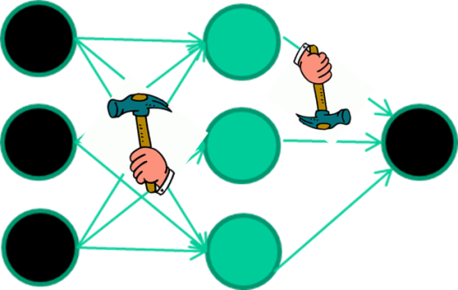
The point I am trying to make
weight-learning algorithms for NNs are dumb
they work by making thousands and thousands of tiny adjustments, each making the network do better at the most recent pattern, but perhaps a little worse on many others
but, by dumb luck, eventually this tends to be good enough to learn effective classifiers for many real applications

Slide 52
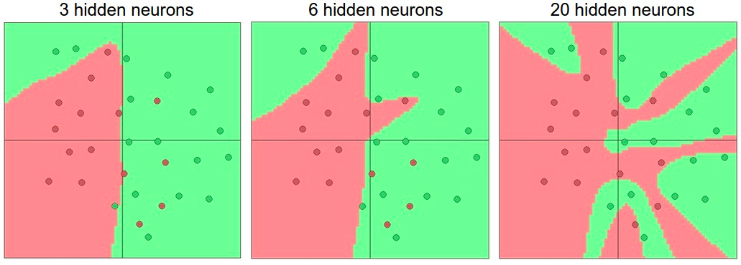
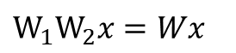
Activation functions
Non-linearities needed to learn complex (non-linear) representations of data, otherwise the NN would be just a linear function
More layers and neurons can approximate more complex functions
$W_{1}W_{2}x=Wx$
http://cs231n.github.io/assets/nn1/layer_sizes.jpeg
Full list: https://en.wikipedia.org/wiki/Activation_function

Slide 53
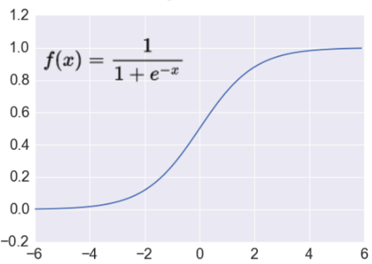
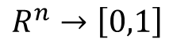
Activation: Sigmoid
Takes a real-valued number and “squashes” it into range between 0 and 1.
$$R^{n}→\left[0,1\right]$$
http://adilmoujahid.com/images/activation.png
Nice interpretation as the firing rate of a neuron
0 = not firing at all
1 = fully firing
Sigmoid neurons saturate and kill gradients, thus NN will barely learn
when the neuron’s activation are 0 or 1 (saturate)
gradient at these regions almost zero
almost no signal will flow to its weights
if initial weights are too large then most neurons would saturate

Slide 54
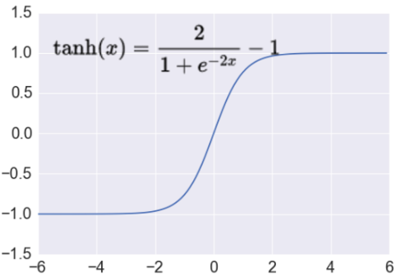
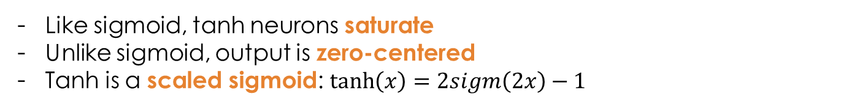
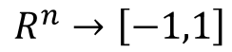
Activation: Tanh
Takes a real-valued number and “squashes” it into range between -1 and 1.
$$R^{n}→\left[−1,1\right]$$
http://adilmoujahid.com/images/activation.png
Like sigmoid, tanh neurons saturate
Unlike sigmoid, output is zero-centered
Tanh is a scaled sigmoid: $\tanh\left(x\right)=2sigm\left(2x\right)−1$
Notes:
not zero-centered: later layers of processing would be receiving data that is not zero-centered.
if data coming into a neuron is always positive then the gradient on the weights will be either all be positive, or all negative (depending on the gradient of the whole expression). Could introduce undesirable zig-zagging dynamics in the gradient weight updates. However, once these gradients are added up across a data batch the final weight update can have variable signs, somewhat mitigating this issue.

Slide 55
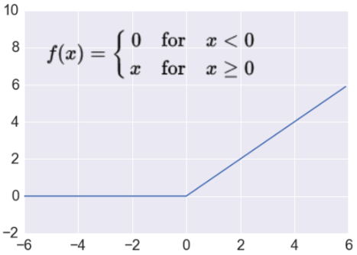
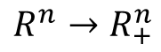
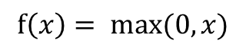
Activation: ReLU
Takes a real-valued number and thresholds it at zero
$$f\left(x\right)= max⁡(0,x)$$
$$R^{n}→R_{+}^{n}$$
http://adilmoujahid.com/images/activation.png
Most Deep Networks use ReLU nowadays
Trains much faster
accelerates convergence of (Stochastic gradient descent) SGD
due to linear, non-saturating form
Less expensive operations
compared to sigmoid/tanh (exponentials etc.)
implemented by simply thresholding a matrix at zero
More expressive
Prevents the gradient vanishing problem
Notes:
ReLU units can “die”
large gradient flowing through a ReLU could cause weights to update in such a way that the neuron will never activate on any datapoint again
gradient flowing through the unit will forever be zero from that point on
With a proper setting of the learning rate this is less frequently an issue

Slide 56
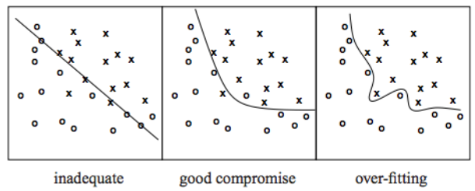
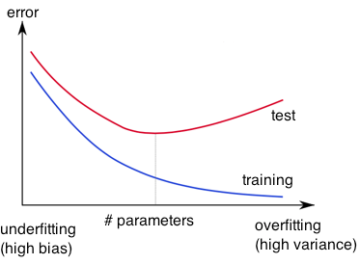
Overfitting
http://wiki.bethanycrane.com/overfitting-of-data
Learned hypothesis may fit the training data very well, even outliers (noise) but fail to generalize to new examples (test data)
https://www.neuraldesigner.com/images/learning/selection_error.svg

Slide 57
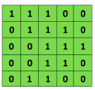

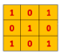
Convolutional Neural Networks (CNNs)
Main CNN idea for text:
Compute vectors for n-grams and group them afterwards
Example: “this takes too long” compute vectors for:
This takes, takes too, too long, this takes too, takes too long, this takes too long
Convolutional
3x3 filter
Input matrix
http://deeplearning.stanford.edu/wiki/index.php/Feature_extraction_using_convolution
Notes:
http://www.asimovinstitute.org/neural-network-zoo/

Slide 58
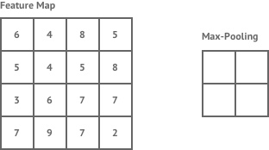
Convolutional Neural Networks (CNNs)
Main CNN idea for text:
Compute vectors for n-grams and group them afterwards
max pool
2x2 filters
and stride 2
https://shafeentejani.github.io/assets/images/pooling.gif

Slide 59
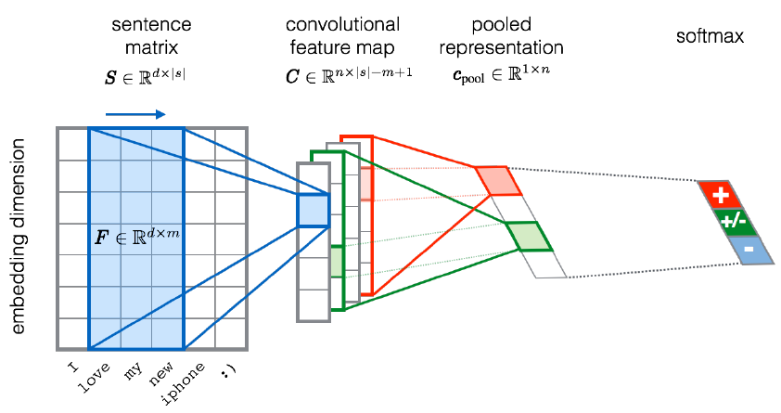
CNN for text classification
Severyn, Aliaksei, and Alessandro Moschitti. "UNITN: Training Deep Convolutional Neural Network for Twitter Sentiment Classification." SemEval@ NAACL-HLT. 2015.
Notes:
the width m of the convolution filters is set to 5
n = 300 feature maps
first layer embeds words into low-dimensional vectors.

Slide 60
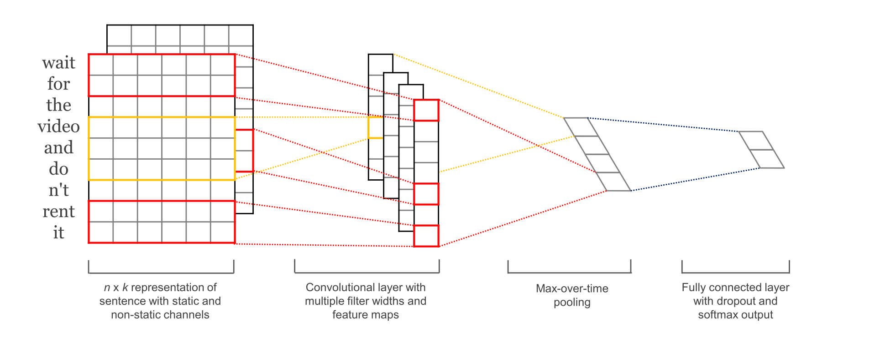
CNN with multiple filters
Kim, Y. “Convolutional Neural Networks for Sentence Classification”, EMNLP (2014)
sliding over 3, 4 or 5 words at a time

Slide 61
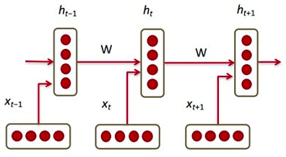




Recurrent Neural Networks (RNNs)
Main RNN idea for text:
Condition on all previous words
Use same set of weights at all time steps
$$h_{t}= σ(W^{(hh)}h_{t−1}+W^{(hx)}x_{t})$$
$$≜$$
https://pbs.twimg.com/media/C2j-8j5UsAACgEK.jpg
Stack them up, Lego fun!
Vanishing gradient problem
https://discuss.pytorch.org/uploads/default/original/1X/6415da0424dd66f2f5b134709b92baa59e604c55.jpg
Notes:
https://pbs.twimg.com/media/C2j-8j5UsAACgEK.jpg

Slide 62
Features / Input representation
context-wise split of the sentence
Embeddings Left
Embeddings Middle
Embeddings Right
2) word sequences concatenated with positional features
Word indices
[5, 7, 12, 6, 90 …]
Position indices e₁
[-1, 0, 1, 2, 3 …]
Position indices e₂
[-4, -3, -2 -1, 0]
Word Embeddings
Positional emb. e₁
Positional emb. e₂
3) concatenating embeddings of two entities with average of word embeddings for rest of the words
Embeddings e₁
Embeddings e₂
context embeddings

Slide 63
Models: MLP
Component-Whole(e₁ , e₂ ) ?
YES / NO
Sigmoid
Dense Layer n
…
Dense Layer 1
Embeddings e₁
context embeddings
Embeddings e₂
Simple fully-connected multi-layer perceptron

Slide 64
Models: CNN
Sigmoid
Component-Whole(e₁ , e₂ ) ?
YES / NO
Max Pooling
Max Pooling
Max Pooling
Convolutional Layer
Convolutional Layer
Convolutional Layer
Embeddings Left
Embeddings Middle
Embeddings Right
OR
Word indices
[5, 7, 12, 6, 90 …]
Position indices e₁
[-1, 0, 1, 2, 3 …]
Position indices e₂
[-4, -3, -2 -1, 0]
Word Embeddings
Positional emb. e₁
Positional emb. e₂
Zeng, D.et al. “Relation classication via convolutional deep neural network”.COLING (2014)

Slide 65
Deep Learning Today
Advancement in speech recognition in the last 2 years
A few long-standing performance records were broken with deep learning methods
Microsoft and Google have both deployed DL-based speech recognition systems in their products
Advancement in Computer Vision
Feature engineering is the bread-and-butter of a large portion of the CV community, which creates some resistance to feature learning
But the record holders on ImageNet and Semantic Segmentation are convolutional nets
Advancement in Natural Language Processing
Fine-grained sentiment analysis, syntactic parsing
Language model, machine translation, question answering

Slide 66

Deep Learning = Learning Hierarchical Representations

Slide 67
Convolutional Neural Network (CNN)
Convolutional Neural Networks are inspired by mammalian visual cortex.
The visual cortex contains a complex arrangement of cells, which are sensitive to small sub-regions of the visual field, called a receptive field. These cells act as local filters over the input space and are well-suited to exploit the strong spatially local correlation present in natural images.
Two basic cell types:
Simple cells respond maximally to specific edge-like patterns within their receptive field.
Complex cells have larger receptive fields and are locally invariant to the exact position of the pattern.

Slide 68
CNN Architecture
Intuition: Neural network with specialized connectivity structure,
Stacking multiple layers of feature extractors
Low-level layers extract local features.
High-level layers extract learn global patterns.
A CNN is a list of layers that transform the input data into an output class/prediction.
There are a few distinct types of layers:
Convolutional layer
Non-linear layer
Pooling layer

Slide 69

CNN Example

Slide 70

Building-blocks for CNN’s
Feature maps of a larger region are combined.
Feature maps are trained with neurons.
Shared weights
Each sub-region yields a feature map, representing its feature.
Images are segmented into sub-regions.

Slide 71
CNN Architecture: Convolutional Layer
The core layer of CNNs
The convolutional layer consists of a set of filters.
Each filter covers a spatially small portion of the input data.
Each filter is convolved across the dimensions of the input data, producing a multidimensional feature map.
As we convolve the filter, we are computing the dot product between the parameters of the filter and the input.
Intuition: the network will learn filters that activate when they see some specific type of feature at some spatial position in the input.
The key architectural characteristics of the convolutional layer is local connectivity and shared weights.

Slide 72
CNN Convolutional Layer: Local Connectivity
Neurons in layer m are only connected to 3 adjacent neurons in the m-1 layer.
Neurons in layer m+1 have a similar connectivity with the layer below.
Each neuron is unresponsive to variations outside of its receptive field with respect to the input.
Receptive field: small neuron collections which process portions of the input data
The architecture thus ensures that the learnt feature extractors produce the strongest response to a spatially local input pattern.

Slide 73
CNN Convolutional Layer Shared Weights
We show 3 hidden neurons belonging to the same feature map (the layer right above the input layer).
Weights of the same color are shared—constrained to be identical.
Gradient descent can still be used to learn such shared parameters, with only a small change to the original algorithm.
The gradient of a shared weight is simply the sum of the gradients of the parameters being shared.
Replicating neurons in this way allows for features to be detected regardless of their position in the input.
Additionally, weight sharing increases learning efficiency by greatly reducing the number of free parameters being learnt.

Slide 74

CNN Architecture: Non-linear Layer
Intuition: Increase the nonlinearity of the entire architecture without affecting the receptive fields of the convolution layer
A layer of neurons that applies the non-linear activation function, such as,
$f\left(x\right)=\max{(0,x)}$
$f\left(x\right)=\tanh{x}$
$f\left(x\right)=|\tanh{x}|$
$f\left(x\right)={(1+e^{−x})}^{−1}$

Slide 75


CNN Architecture: Pooling Layer
Intuition: to progressively reduce the spatial size of the representation to reduce the amount of parameters and computation in the network, and hence to also control overfitting
Pooling partitions the input image into a set of non-overlapping rectangles and, for each such sub-region, outputs the maximum value of the features in that region.
Input

Slide 76
Building-blocks for CNN’s
Feature maps of a larger region are combined.
Feature maps are trained with neurons.
Shared weights
Each sub-region yields a feature map, representing its feature.
Images are segmented into sub-regions.

Slide 77

Full CNN
pooling
pooling

Slide 78

Motivation: Fully-Connected Layers Are Limited
Each node provides input to each node in the next layer
• Assume 3-layer model with 100 nodes, 100 nodes, and then 2 nodes
• e.g., how many weights are in a 640x480 grayscale image?
• 640x480x100 + 100x100 + 100x2 = 30,730,200
• e.g., how many weights are in a 3.1 Megapixel grayscale image (2048X1536)?
• 2048x1536x100 + 100x100 + 100x2 = 314,583,000

Slide 79
Motivation: Fully-Connected Layers Are Limited
Issue: many model parameters in fully connected networks
• Assume 3-layer model with 100 nodes, 100 nodes, and then 2 nodes
• e.g., how many weights are in a 640x480 grayscale image?
• 640x480x100 + 100x100 + 100x2 = 30,730,200
• e.g., how many weights are in a 3.1 Megapixel grayscale image (2048X1536)?
• 2048x1536x100 + 100x100 + 100x2 = 314,583,000

Slide 80
Motivation: Fully-Connected Layers Are Limited
Many model parameters…
increases chance of overfitting
requires more training data
increases memory/storage requirements
• Assume 3-layer model with 100 nodes, 100 nodes, and then 2 nodes
• e.g., how many weights are in a 640x480 grayscale image?
• 640x480x100 + 100x100 + 100x2 = 30,730,200
• e.g., how many weights are in a 3.1 Megapixel grayscale image (2048X1536)?
• 2048x1536x100 + 100x100 + 100x2 = 314,583,000

Slide 81


Key Ingredient 1: Convolutional Layers
Rather than have each node provide input to each node in the next layer…
Fully-connected:
each node receives input only from a small neighborhood in previous layer (and there is parameter sharing)
Convolutional:
Figure Source: https://qph.fs.quoracdn.net/main-qimg-2e1f0071ca9878f7719ed0ea8aeb386d

Slide 82
Fully-Connected vs Convolutional Layers
Fully-connected:
Convolutional layers dramatically reduce number of model parameters!
Convolutional:
Figure Source: https://qph.fs.quoracdn.net/main-qimg-2e1f0071ca9878f7719ed0ea8aeb386d

Slide 83
Key Ingredient 1: Convolutional Layers
INPUT
FILTER
*
=
+ b
ReLU

Slide 84






Recall: Image Representation (8-bit Grayscale)
https://ai.stanford.edu/~syyeung/cvweb/tutorial1.html

Slide 85
Key Ingredient 1: Convolutional Layers
INPUT
FILTER
*
=
+ b
ReLU

Slide 86


Convolution: Applies Linear Filter (e.g., 2D)
Way to Interpret Neural Network
Input
Filter (aka – Kernel)
Feature Map
Compute a function of local neighborhood for each location in matrix
A filter specifies the function for how to combine neighbors’ values
https://www.jefkine.com/general/2016/09/05/backpropagation-in-convolutional-neural-networks/

Slide 87

2D Filtering
Matrix:
Filtered Result:
Slides filter over the matrix and computes dot products
https://people.eecs.berkeley.edu/~jrs/189/lec/cnn.pdf

Slide 88

2D Filtering
Matrix:
Filtered Result:
Slides filter over the matrix and computes dot products
https://people.eecs.berkeley.edu/~jrs/189/lec/cnn.pdf

Slide 89

2D Filtering
Matrix:
Filtered Result:
Slides filter over the matrix and computes dot products
https://people.eecs.berkeley.edu/~jrs/189/lec/cnn.pdf

Slide 90
2D Filtering
Matrix:
Filtered Result:
Slides filter over the matrix and computes dot products
https://people.eecs.berkeley.edu/~jrs/189/lec/cnn.pdf

Slide 91
2D Filtering: Toy Example
Input
Filter
Feature Map
 |  |  | 0 | 0
1 | 1 | 1
0 | 1 | 1 | 1 | 0
0 | 0 | 1 | 1 | 1
 |  |  | 1 | 0
0 | 0 | 1
0 | 1 | 1 | 0 | 0
1 | 0 | 1
0 | 1 | 0
1 | 0 | 1
? | ? | ?
? | ? | ?
? | ? | ?
Dot Product = 1*1 + 1*0 + 1*1 + 0*0 + 1*1 + 1*0 + 0*1 + 0*1 + 0*0 + 0*0 + 1*1 Dot Product = 4

Slide 92
2D Filtering: Toy Example
Input
Filter
Feature Map
1 | 1 | 1 | 0 | 0
0 | 1 | 1 | 1 | 0
0 | 0 | 1 | 1 | 1
0 | 0 | 1 | 1 | 0
0 | 1 | 1 | 0 | 0
1 | 0 | 1
0 | 1 | 0
1 | 0 | 1
4 | ? | ?
? | ? | ?
? | ? | ?

Slide 93
2D Filtering: Toy Example
Input
Filter
Feature Map
1
 | 1 |  | 1 | 0 | 0
0 | 1 |  | 1 | 1 | 0
0 | 0 |  | 1 | 1 | 1
0
 | 0 |  | 1 | 1 | 0
0 | 1 |  | 1 | 0 | 0
1 | 0 | 1
0 | 1 | 0
1 | 0 | 1
4 | 3 | ?
? | ? | ?
? | ? | ?

Slide 94
2D Filtering: Toy Example
Input
Filter
Feature Map
1 | 1 | 1 | 0 |  | 0
0 | 1 | 1 | 1 |  | 0
0 | 0 | 1 | 1 |  | 1
0 | 0 | 1 | 1 |  | 0
 |  |  |  |  | 0
0 | 1 | 1 | 0
1 | 0 | 1
0 | 1 | 0
1 | 0 | 1
4 | 3 | 4
? | ? | ?
? | ? | ?

Slide 95
2D Filtering: Toy Example
Input
Filter
Feature Map
1 | 1 | 1 | 0 |  | 0
0 | 1 | 1 | 1 |  | 0
0 | 0 | 1 | 1 |  | 1
0 | 0 | 1 | 1 |  | 0
 |  |  |  |  | 0
0 | 1 | 1 | 0
1 | 0 | 1
0 | 1 | 0
1 | 0 | 1
4 | 3 | 4
2 | ? | ?
? | ? | ?

Slide 96
2D Filtering: Toy Example
Input
Filter
Feature Map
1 | 1 |  | 1 | 0 | 0
0 | 1 |  | 1 | 1 | 0
0 | 0 |  | 1 | 1 | 1
0 | 0 |  | 1 | 1 | 0
0
 | 1 |  | 1 | 0 | 0
1 | 0 | 1
0 | 1 | 0
1 | 0 | 1
4 | 3 | 4
2 | 4 | ?
? | ? | ?

Slide 97
2D Filtering: Toy Example
Input
Filter
Feature Map
1 | 1 | 1 | 0 |  | 0
0 | 1 | 1 | 1 |  | 0
 |  |  |  |  | 1
0 | 0 | 1 | 1
0 | 0 | 1 | 1 |  | 0
0 | 1 | 1 | 0 |  | 0
1 | 0 | 1
0 | 1 | 0
1 | 0 | 1
4 | 3 | 4
2 | 4 | 3
? | ? | ?

Slide 98
2D Filtering: Toy Example
Input
Filter
Feature Map
1 | 1 | 1 | 0 |  | 0
0 | 1 | 1 | 1 |  | 0
 |  |  |  |  | 1
0 | 0 | 1 | 1
0 | 0 | 1 | 1 |  | 0
0 | 1 | 1 | 0 |  | 0
1 | 0 | 1
0 | 1 | 0
1 | 0 | 1
4 | 3 | 4
2 | 4 | 3
2 | ? | ?

Slide 99
2D Filtering: Toy Example
Input
Filter
Feature Map
1 | 1 |  | 1 | 0 | 0
0 | 1 |  | 1 | 1 | 0
0
 | 0 |  | 1 | 1 | 1
0 | 0 |  | 1 | 1 | 0
0 | 1 |  | 1 | 0 | 0
1 | 0 | 1
0 | 1 | 0
1 | 0 | 1
4 | 3 | 4
2 | 4 | 3
2 | 3 | ?

Slide 100
2D Filtering: Toy Example
Input
Filter
Feature Map
1 | 1 | 1 | 0 | 0
0 | 1 | 1 | 1 | 0
0 | 0 | 1 | 1 | 1
0 | 0 | 1 | 1 | 0
0 | 1 | 1 | 0 | 0
1 | 0 | 1
0 | 1 | 0
1 | 0 | 1
4 | 3 | 4
2 | 4 | 3
2 | 3 | 4

Slide 101
Convolutional Layer
Many neural network libraries use “convolution” interchangeably with “cross correlation”; for mathematicians, these are technically different
Examples in these slides show the “cross-correlation” function
Way to Interpret Neural Network
Input
Filter (aka – Kernel)
Feature Map
https://www.jefkine.com/general/2016/09/05/backpropagation-in-convolutional-neural-networks/

Slide 102
Convolutional Layer: Parameters to Learn
Way to Interpret Neural Network
Input
Filter (aka – Kernel)
Feature Map
https://www.jefkine.com/general/2016/09/05/backpropagation-in-convolutional-neural-networks/

Slide 103
Convolutional Layer: Parameters to Learn
For shown example, how many weights must be learned?
4 (red, blue, yellow, and green values)
If we instead used a fully connected layer, how many weights would need to be learned?
36 (9 turquoise nodes x 4 magenta nodes)
https://www.jefkine.com/general/2016/09/05/backpropagation-in-convolutional-neural-networks/

Slide 104
Convolutional Layer: Parameters to Learn
Neocognitron hard-coded filter values... filter values are learned for CNNs
https://www.jefkine.com/general/2016/09/05/backpropagation-in-convolutional-neural-networks/

Slide 105
Convolutional Layer: What Can Filters Do?
Way to Interpret Neural Network
Input
Filter (aka – Kernel)
Feature Map
https://www.jefkine.com/general/2016/09/05/backpropagation-in-convolutional-neural-networks/

Slide 106


Convolutional Layer: What Can Filters Do?
Filter

Slide 107

Convolutional Layer: What Can Filters Do?
e.g.,
Filter Visualization of Filter
Image Credit: https://adeshpande3.github.io/A-Beginner%27s-Guide-To-Understanding-Convolutional-Neural-Networks/

Slide 108


Convolutional Layer: What Can Filters Do?
Filter Overlaid on Image
e.g.,
Image
Filter
Weighted Sum = ?
Weighted Sum = (50x30) + (20x30) + (50x30) + (50x3) + (50x30)
Weighted Sum = 6600 (Large Number!!)
Image Credit: https://adeshpande3.github.io/A-Beginner%27s-Guide-To-Understanding-Convolutional-Neural-Networks/

Slide 109


Convolutional Layer: What Can Filters Do?
Filter Overlaid on Image
e.g.,
Image
Filter
Weighted Sum = ?
Weighted Sum = 0 (Small Number!!)
Image Credit: https://adeshpande3.github.io/A-Beginner%27s-Guide-To-Understanding-Convolutional-Neural-Networks/

Slide 110
Convolutional Layer: What Can Filters Do?
This Filter is a Curve Detector!
e.g.,
Filter Overlaid on Image (Big Response!)
Filter Overlaid on Image (Small Response!)
Image Credit: https://adeshpande3.github.io/A-Beginner%27s-Guide-To-Understanding-Convolutional-Neural-Networks/

Slide 111


Convolutional Layer: What Can Filters Do?
Filter Feature Map Filter
Feature Map
https://ujjwalkarn.me/2016/08/11/intuitive-explanation-convnets/

Slide 112

Convolutional Layer: What Can Filters Do?
Demo: http://beej.us/blog/data/convolution-image-processing/

Slide 113
Key Ingredient 1: Convolutional Layers
INPUT
FILTER
*
=
+ b
ReLU
Can choose filters of any size to support feature learning!

Slide 114
Key Ingredient 1: Convolutional Layers
INPUT
FILTER
=
* + b
ReLU
Filtered results are passed, with a bias term, through an activation function to create activation/feature maps

Slide 115

Key Ingredient 1: Convolutional Layers
FILTER
INPUT
=
ReLU
+ b
*
=
+ b
ReLU
Can have multiple filters (with a unique bias parameter per filter)

Slide 116
Key Ingredient 1: Convolutional Layer Summary
FILTER
INPUT
=
ReLU
+ b
*
=
+ b
ReLU
Neural networks learn values for all filters and biases in all layers

Slide 117

How Filters Are Applied to Multi-Channel Inputs
e.g., RGB images
https://www.geeksforgeeks.org/matlab-rgb-image-representation/

Slide 118

How Filters Are Applied to Multi-Channel Inputs
Number of channels in a filter matches that of the input
https://indoml.com/2018/03/07/student-notes-convolutional-neural-networks-cnn-introduction/

Slide 119

Convolutional Layers Stacked
Can then stack a sequence of convolution layers; e.g.,
http://cs231n.stanford.edu/slides/2019/cs231n_2019_lecture05.pdf

Slide 120

Convolutional Layers Stacked
Can then stack a sequence of convolution layers, which leads to identifying patterns in increasingly larger regions of the input (e.g., pixel) space:
https://www.deeplearningbook.org/contents/convnets.html

Slide 121
Convolutional Layers Stacked
Can then stack a sequence of convolution layers, which leads to identifying patterns in increasingly larger regions of the input (e.g., pixel) space and mimicking vision system:
Higher level features are constructed by combining lower level features
Source: https://bruceoutdoors.files.wordpress.com/2017/08/hubel.jpg

Slide 122
Problem #1: Input Shrinks
Why do the dimensions shrink with each convolutional layer?
Information is lost around boundary of the input!
http://cs231n.stanford.edu/slides/2019/cs231n_2019_lecture05.pdf

Slide 123

Solution: Control Output Size with Padding
Padding: add values at the boundaries
Image Credit: https://software.intel.com/en-us/node/586159

Slide 124
Problem #2: Computation Expensive
Matrix:
Filtered Result:
Many computations to slide filter over every point in the matrix and compute dot products
https://people.eecs.berkeley.edu/~jrs/189/lec/cnn.pdf

Slide 125


Idea: Reduce Computations with Stride
Stride: how many steps taken spatially before applying a filter
e.g., 2x2
Image Filter Feature Map
4 | 4
2 | 4
http://deeplearning.net/software/theano/tutorial/conv_arithmetic.html

Slide 126
Convolutional Layers: Parameters vs Hyperparameters
Parameters
Weights
Biases
Hyperparameters:
Number of filters, including height and width of each
Padding type
Strides

Slide 127
Today’s Topics
Neural Networks for Spatial Data
History of Convolutional Neural Networks (CNNs)
CNNs – Convolutional Layers
CNNs – Pooling Layers
Programming Tutorial

Slide 128

Pooling Layer: Summarizes Neighborhood
Max-pooling: partitions input into a set of non-overlapping rectangles and outputs the maximum value for each chunk
? | ?
? | ?
http://cs231n.github.io/convolutional-networks/#pool

Slide 129
Pooling Layer: Summarizes Neighborhood
Max-pooling: partitions input into a set of non-overlapping rectangles and outputs the maximum value for each chunk
http://cs231n.github.io/convolutional-networks/#pool

Slide 130

Pooling Layer: Summarizes Neighborhood
Max-pooling: partitions input into a set of non-overlapping rectangles and outputs the maximum value for each chunk
http://cs231n.github.io/convolutional-networks/#pool

Slide 131

Pooling Layer
Resilient to small translations
e.g.,
Input: all values change (shift right)
Output: only half the values change
https://www.deeplearningbook.org/contents/convnets.html

Slide 132
Pooling Layer: Summarizes Neighborhood
Max-pooling: partitions input into a set of non-overlapping rectangles and outputs the maximum value for each chunk
Average-pooling: partitions input into a set of non-overlapping rectangles and outputs the average value for each chunk
Avg
? | ?
? | ?
http://cs231n.github.io/convolutional-networks/#pool

Slide 133
Pooling Layer: Summarizes Neighborhood
Max-pooling: partitions input into a set of non-overlapping rectangles and outputs the maximum value for each chunk
Average-pooling: partitions input into a set of non-overlapping rectangles and outputs the average value for each chunk
Avg
3.25 | 5.25
2 | 2
http://cs231n.github.io/convolutional-networks/#pool

Slide 134
Pooling Layer: Summarizes Neighborhood
Max-pooling: partitions input into a set of non-overlapping rectangles and outputs the maximum value for each chunk
Average-pooling: partitions input into a set of non-overlapping rectangles and outputs the average value for each chunk
And many more pooling options
E.g., listed here https://pytorch.org/docs/stable/
nn.h
tml#pooling-layers

Slide 135

Pooling for Multi-Channel Input
Pooling is applied to each input channel separately
https://indoml.com/2018/03/07/student-notes-convolutional-neural-networks-cnn-introduction/

Slide 136
Pooling Layer: Benefits
Builds in invariance to translations of the input
Reduces memory requirements
Reduces computational requirements

